Slide 1
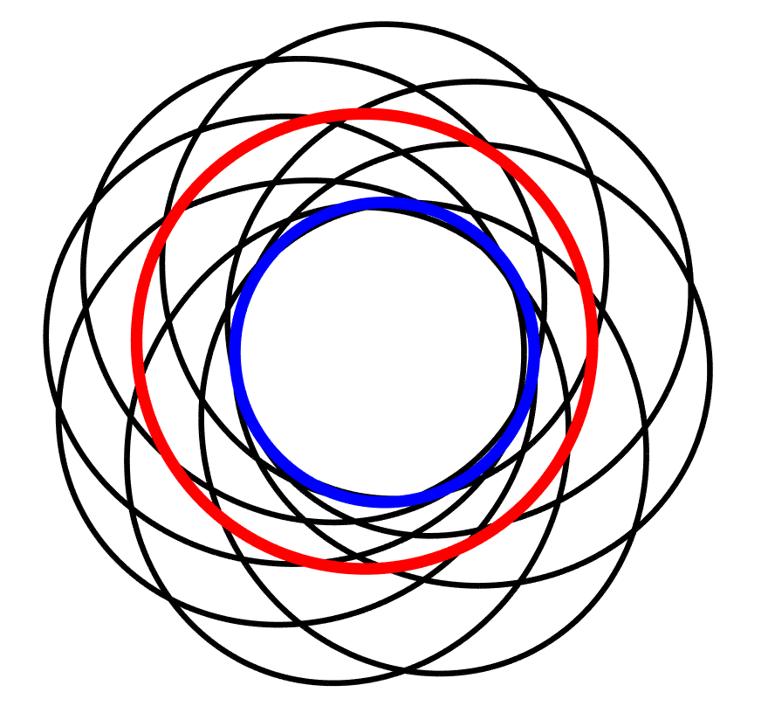



Trajectory Optimization for Shuttle Via Earth-Mars Cycler
Kyle Newlin, College of Engineering
Dr. Davide Conte, Dept. of Aerospace Engineering
2024 Arizona Space Grant Symposium
Tucson, AZ

Slide 2

Intro / Objective
Cyclers are trajectories that in ideal conditions would allow a spacecraft to continually revisit two different planets, requiring just one significant burn.
This project aims to produce a MATLAB algorithm capable of optimizing and tailoring Earth-Mars cyclers to future interplanetary mission requirements.

Slide 3
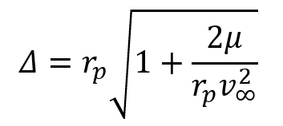
Problem Parameterization
Lambert's Problem:
3D Flyby Targeting Circle:
t_{f}
TOF
r₂
Reference Vector
R_{SOI}
Δθ
Φ
Δ
V∞
Trajectory Plane
r₁
t₀
where TOF = t_{f} - t₀
where

Slide 4
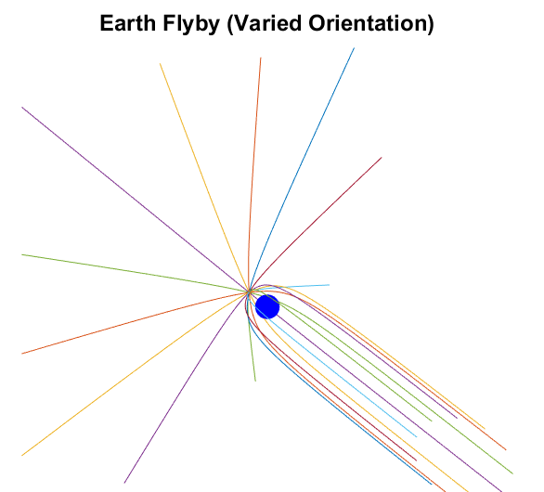
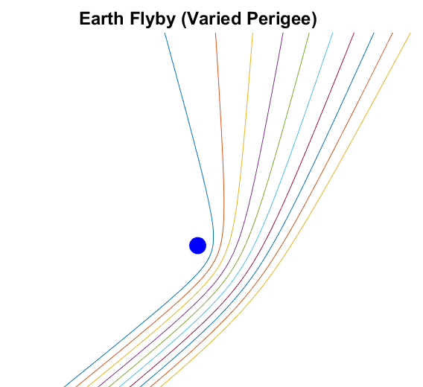
3D Flybys
Earth Flyby (Varied Perigee):
Earth Flyby (Varied Orientation):

Slide 5
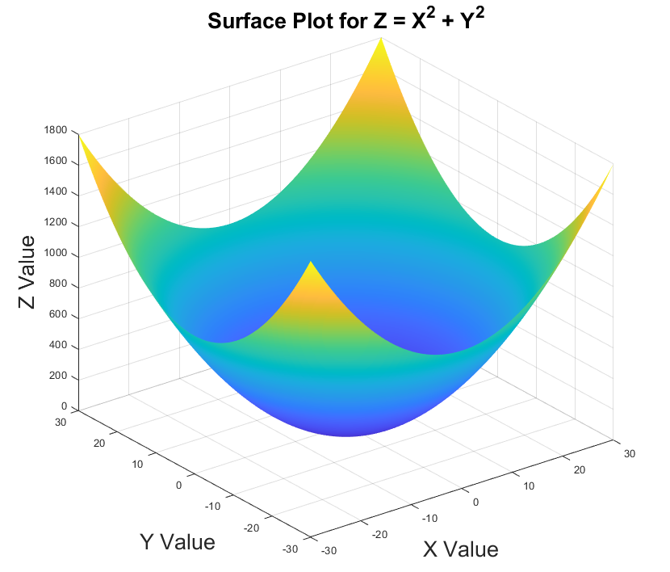
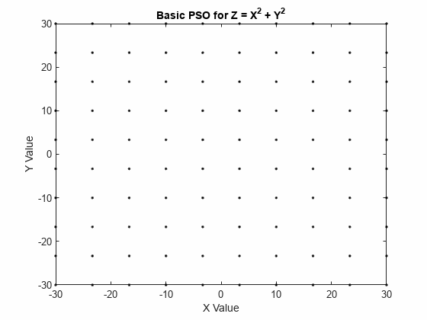
Particle Swarm Optimization
Objective Function Z = X² + Y²
PSO: find X,Y for minimal Z

Slide 6
PSO Applied to Cyclers
Particle Elements:
X = [ JD_{launch}, --, -- , TOF_{M1}, Δ_{M1}, Φ_{M1}, TOF_{E1} … (Free Return: 5D)
Δ_{E1}, Φ_{E1}, TOF_{M2}, Δ_{M2}, Φ_{M2}, TOF_{E2} … (2 Round Trips: 11D)
Δ_{E2}, Φ_{E2}, TOF_{M3}, Δ_{M3}, Φ_{M3}, TOF_{E3} ] … (3 Round Trips: 17D)
… (n Round Trips: 5+6n D)
V∞⁺
ΔV_{i}
Objective Function:
Z = ΔV_{i} + ΔV_{m}(2 x n)
(Initial and Continual Maintenance Burns)
ΔV’s Evaluated through Lambert's Problem And Planetary Positions/Velocity Provided by NASA JPL Horizons
V∞⁻
V∞⁺
ΔV_{m}

Slide 7
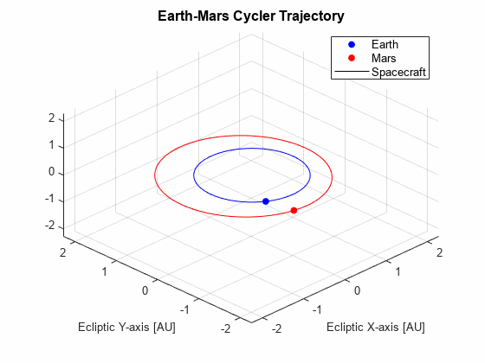
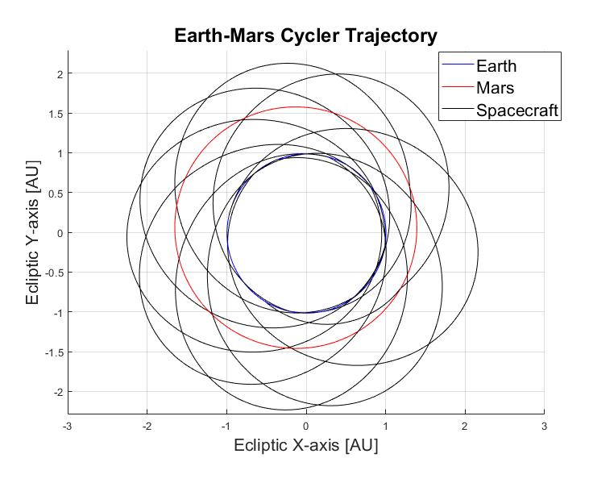
Earth-Mars Cycler (Inbound)

Slide 8
Results and Interpretations
Launch Date | Inbound: 16-Feb-2033 Outbound: 17-Dec-2033
Avg. TOF (Inbound Transfer) | 139 days
Avg. TOF (Outbound Transfer) | 636 days
Avg. TOF (Per Round Trip) | 775 days
Initial ΔV | 5.12 km/s
Avg. Maintenance ΔV (Per Round Trip) | 0.23 km/s

